Slide 1
Shark Attacks Report
Oscar Reinoso

Slide 2
Index
STANDARIZATION & DATA SELECTION
DATA CLEANING & TRANSFORMATION
DATA DESCRIPTION
MULTIVARIABLE ANALYSIS

Slide 3

STANDARIZATION & DATA SELECTION
Formatting to lower.case columns and clean empty spaces.
Remove empty columns and columns with non-relevant information.
Remove all empty rows.
Inconsistent data: Historical data two far away and with too much dispersion between them. This dilimited the analysis to 1800-2024.

Slide 4
DATA CLEANING & TRANSFORMATION
DATA CLEANING
TRANSFORMATION
Fillna Strategies in categorical variables for empty spaces and trash’s entries.
Drop no specific locations
Fill with John-Jane Doe in name.
Dropna Strategies with numerical variables. (filtered)
Drop duplicates
unnamed_01 = survived (bolean)
Rename columns and values
Date to datatime
Time to datatime (after string)
Year to int.
5493 entradas en 13 variables (1 numerical, 1 time,1 bolean, and 10 categorical)

Slide 5
Last Transformations
Create non_zero_columns (age, time)
Create country_group and activity_group columns
Create injury_survived column

Slide 6
DATA DESCRIPTION

Slide 7
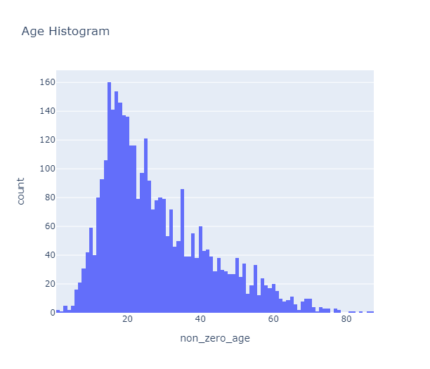
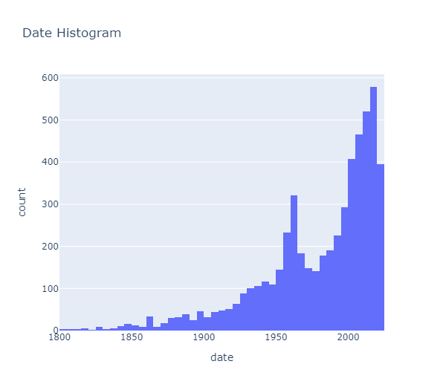
Numerical Variables

Slide 8
Descriptive statistics for age: Age Mean: 27.95 Age Mode: 15 Percentile 25%: 17.0 Age Median: 24.0 Percentile 75%: 36.0 Age Standard Deviation: 14.53
The average age of a shark attack victim is around 28 years, however due to a high standard deviation this average is not representative.
To understand this variable, we looked at the mode and median and the histogram showing that most victims are 24 years old or younger and are concentrated in the 17-36 age range, with the most frequent age being 15 years old. 75% of values are concentrated between 1-36 years old.
The day with the most reported attacks in the sample is New Year's Day 1942.
Fifty percent of the attacks have been reported since 1993.
Descriptive statistics for date: Mode: 1942-01-01
Median: 1993-03-22

Slide 9
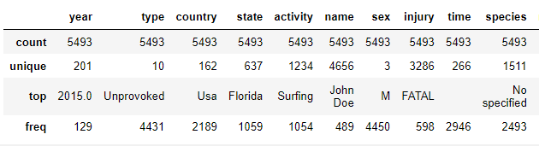
Categorical Variables

Slide 10
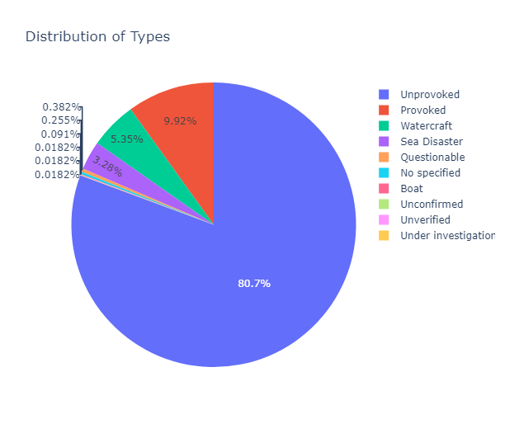
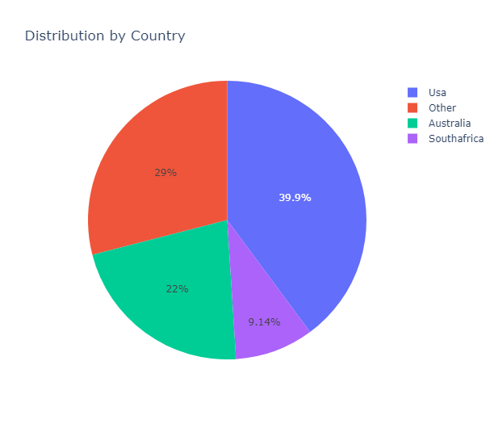
Type & Country

Slide 11
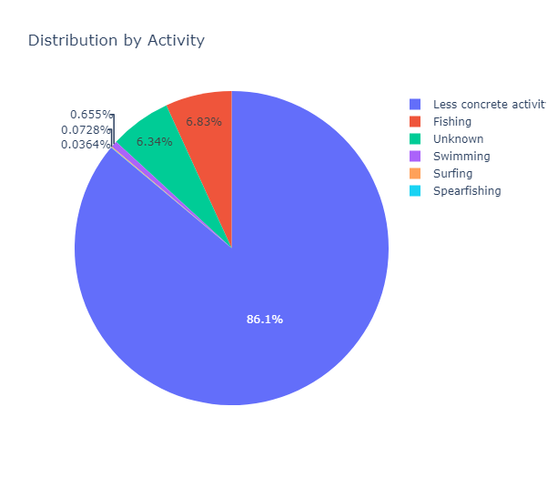
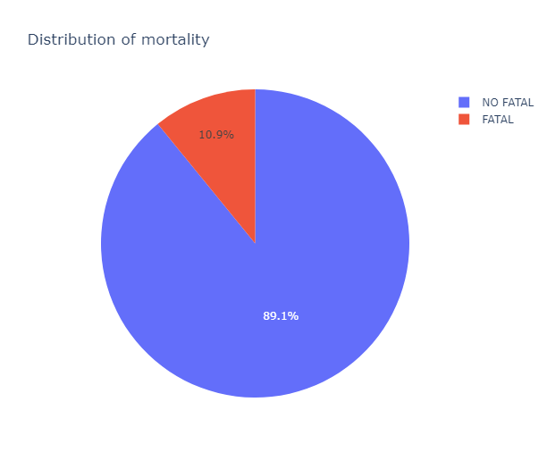
Activity & Mortality

Slide 12
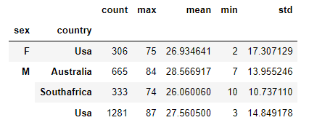
MULTIVARIABLE ANALYSIS Age by sex & country (300)
What are the statistical attacks distributions by age and for sex in the top 3 countries?

Slide 13
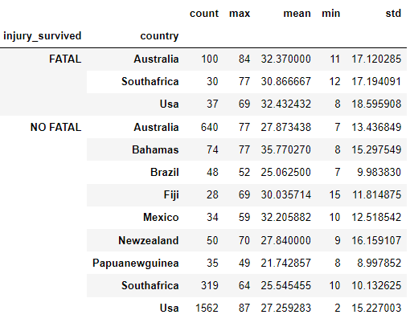
MULTIVARIABLE ANALYSIS Age by mortality & country (300)
What are the statistical characteristics, of fatal and non-fatal injuries across different countries? Do the most attacked country mean most mortality?

Slide 14
Thanks

